Slide 1
RAFT Consensus

Slide 2
RAFT Consensus
Basic idea -
The nodes collectively selects a leader; others become followers
The leader is responsible for state transition log replication across the followers

Slide 3
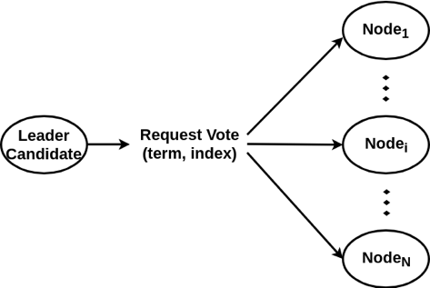
Electing the Leader: Voting Request
term: last calculated # known to candidate + 1
index: committed transaction available to the candidate

Slide 4
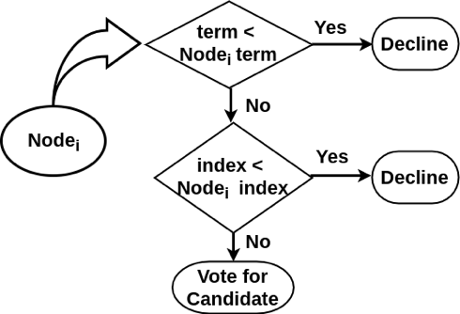
Electing the leader: Follower Node’s Decision Making
Each node compares received term and index with corresponding current known values

Slide 5
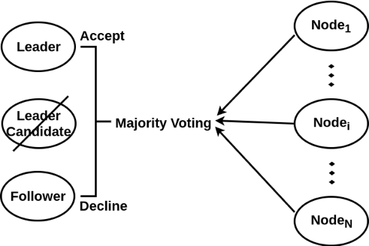
Electing the leader: Majority Voting
Use of Majority voting
leader selection
commit the log entry

Slide 6
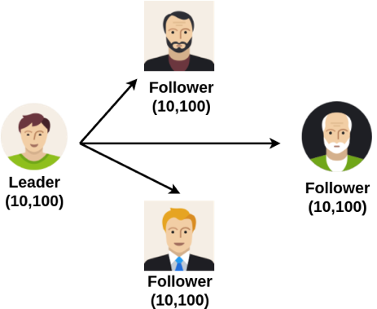
Multiple Leader Candidates: Current Leader Failure
A leader with three followers
term: 10
commit index: 100

Slide 7
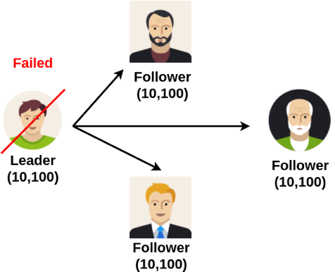
Multiple Leader Candidates: Current Leader Failure
The leader node failed

Slide 8
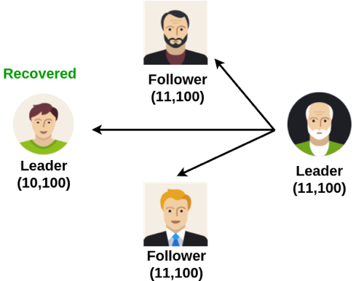
Multiple Leader Candidates: Current Leader Failure
New leader elected with term 11
Old leader recovered

Slide 9
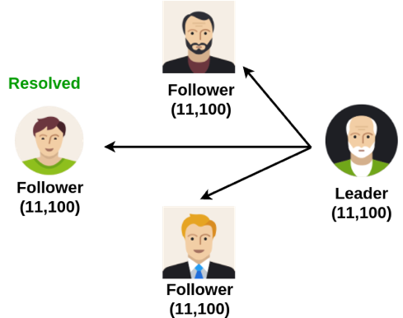
Multiple Leader Candidates: Current Leader Failure
Old leader receive heartbeat message from new leader with greater term
Old leader drops to follower state

Slide 10
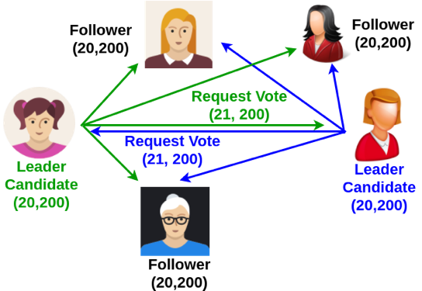
Multiple Leader Candidates: Simultaneous Request Vote
Two nodes send Request vote message with term 21 at the same time

Slide 11
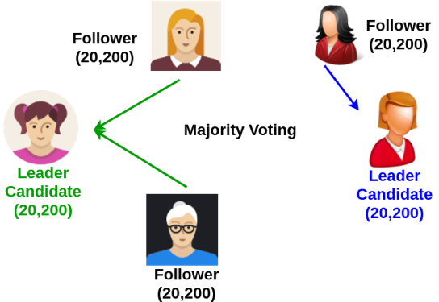
Multiple Leader Candidates: Simultaneous Request Vote
One of them gets majority voting

Slide 12
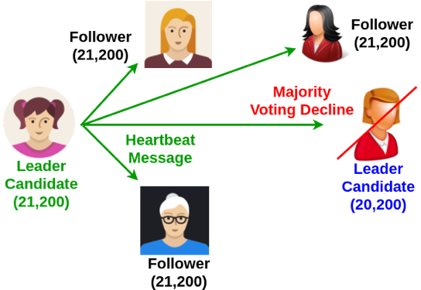
Multiple Leader Candidates: Simultaneous Request Vote
Winner sends heartbeat message

Slide 13
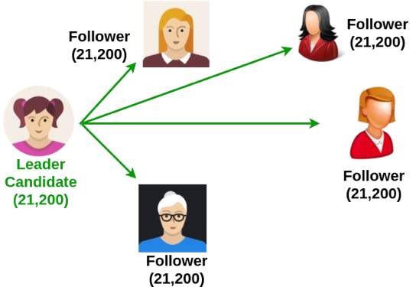
Multiple Leader Candidates: Simultaneous Request Vote
Other leader candidate switches to follower state

Slide 14
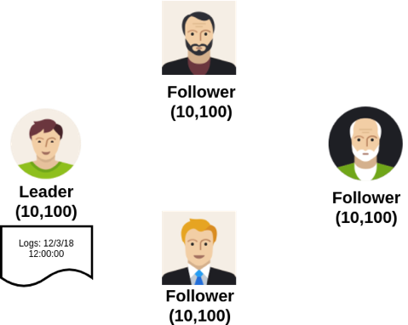
Commiting Entry Log
Leader adds entry to log with term 10 and index 101

Slide 15
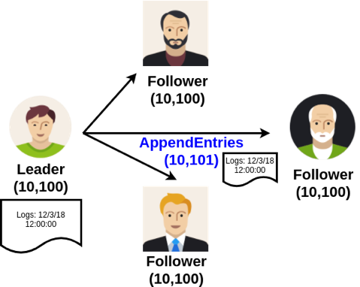
Commiting Entry Log
Leader sends AppendEntries message to followers with index 101

Slide 16
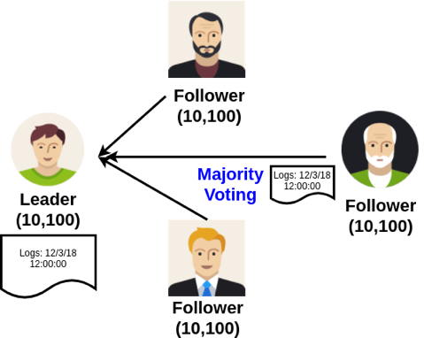
Commiting Entry Log
Majority voting decides to accept or reject the entry log

Slide 17
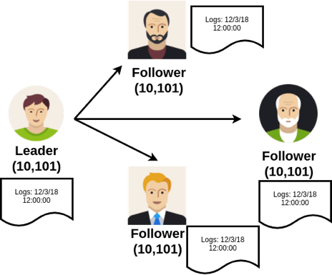
Commiting Entry Log
Successfully accept entry log
– All leader and followers update committed index to 101

